Slide 1
Renaissance Man: Leonardo Da Vinci
Mr. Clutter
VMS Library
Spring 2008

Slide 2
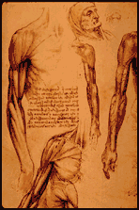
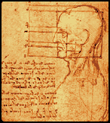
Leonardo the Scientist
Studied many topics such as anatomy, zoology, botany, geology, optics, aerodynamics and hydrodynamics among others
He was fascinated by the study of physiognomy, the “science” of evaluating a person’s character by his or her facial features

Slide 3
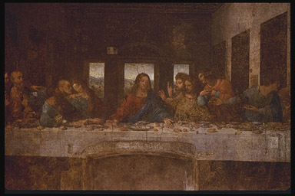
Leonardo the Artist
Leonardo’s desire to paint things realistically was bold and fresh, and eventually became the standard for painters who followed in the 16th century
Went beyond his teaching by making a scientific study of light and shadow in nature
Objects were not comprised of outlines, but were actually 3-D bodies defined by light and shadow
Known as chiaroscuro, this technique gave his paintings the soft, lifelike quality.
The Last Supper

Slide 4
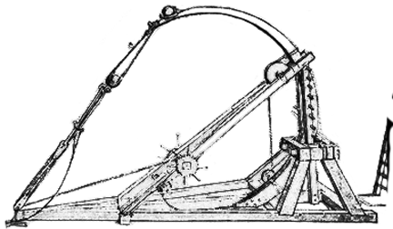
Leonardo the Inventor
Adapted drawing skills to the more lucrative fields of architecture, military engineering, canal building and weapons design
Leonardo wanted to create "new machines" for a "new world“
Based on the gear, he came up with loads of different ideas, including the bicycle, a helicopter, an “auto-mobile”, and many military weapons
Leonardo’s first idea for a catapult

Slide 5
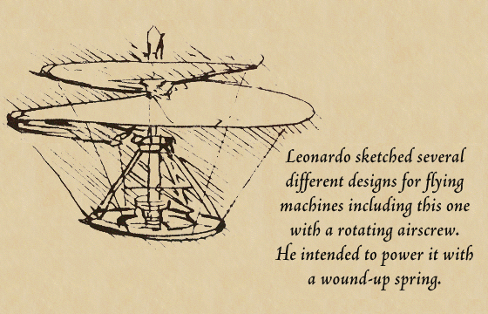
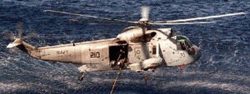
Leonardo’s Helicopter

Slide 6
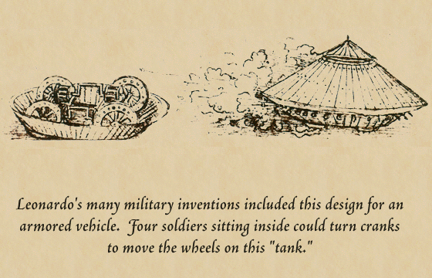
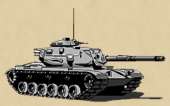
The First Tank

Slide 7
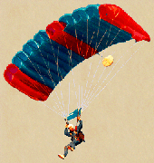
“Leo-chute”

Slide 8
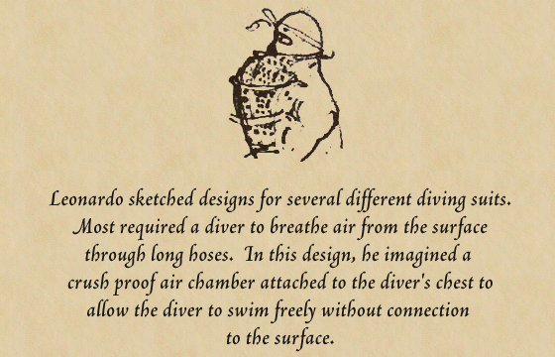
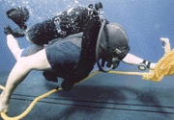
Diving During the Renaissance?

Slide 9
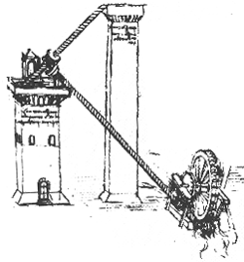
The Water Lift
This invention consists of a water wheel, two screws and two towers
As the water wheel turns, the screws turn, pushing the water up to the highest tower
The tall tower acts as a reservoir for gravity fed water pipes

Slide 10
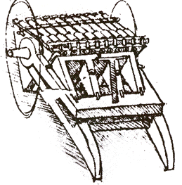
The Machine Gun
This machine actually consisted of three sets of machine guns, set on a rotating drum
When the first set is fired, the force of the explosion would pivot the guns down, bringing the next set of guns to the top, ready to be fired.

Slide 11
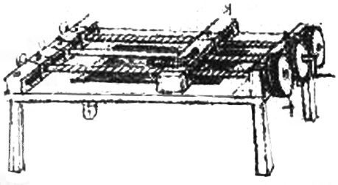
The Thread Cutter
This machine cuts the threads of screws
A bar, the one to have the thread cut into it, would be laid in between the two screws.
As the cranks on the end of the table were turned, the cutting blade would be carried down the two screws, creating an even groove to be used for screws, bolts, etc.

Slide 12
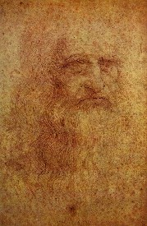
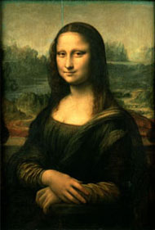
Mystery of the Mona Lisa
He recorded in his notebooks the records of model sittings; but records of the Mona Lisa model sitting are nowhere to be found
Theories are that Leonardo painted himself, and this theory is supported by analyzing the facial features of Leonardo’s face and that of the famous painting
If the features of the face were placed on top of each other, and flipped, they would align perfectly

Slide 13
Right to Left
Leonardo wrote in Italian using a special kind of shorthand that he invented himself
He usually used “mirror writing,” starting at the right side of the page and moving to the left
Only when he was writing something intended for other people did he write in the normal direction
Leonardo’s Signature in a notebook www.mos.org/sln/Leonardo/write.html

Slide 14
This powerpoint was kindly donated to www.worldofteaching.com
http://www.worldofteaching.com is home to over a thousand powerpoints submitted by teachers. This is a completely free site and requires no registration. Please visit and I hope it will help in your teaching.

